Slide 1
Synthesizing Audio using Generative Adversarial Networks
Bowen Zhi
Fan Yang
Patrick Owen
Nadee Seneviratne

Slide 2
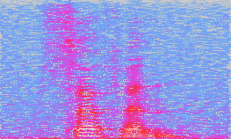
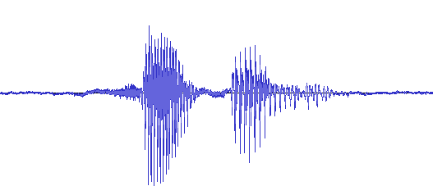

Problem Statement
Unsupervised audio generation
Generative adversarial networks (GANs)

Slide 3
Applications
Music production
Text-to-speech
Data augmentation
Sound design

Slide 4
Generative Adversarial Networks
Generator: maps latent space -> data space
Recently used for unsupervised image generation (e.g. DCGAN [1], BEGAN [2])
Unsupervised audio generation: relatively unexplored
[1] Radford et. al, ICLR 2016.
[2] Brethelot et. al, 2017.

Slide 5
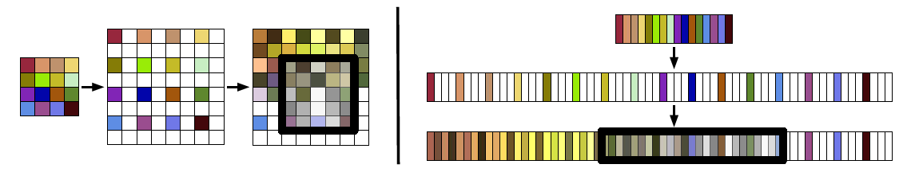
Adversarial Audio Synthesis Donahue et. al, 2018 (ICLR 2019 submission)
Adapt DCGAN architectures to audio
fixed-size images -> fixed-length audio clips
WaveGAN: DCGAN on raw waveforms
5x5 2D convolutions -> 25x1 1D convolutions
Image taken from: https://arxiv.org/pdf/1802.04208.pdf

Slide 6
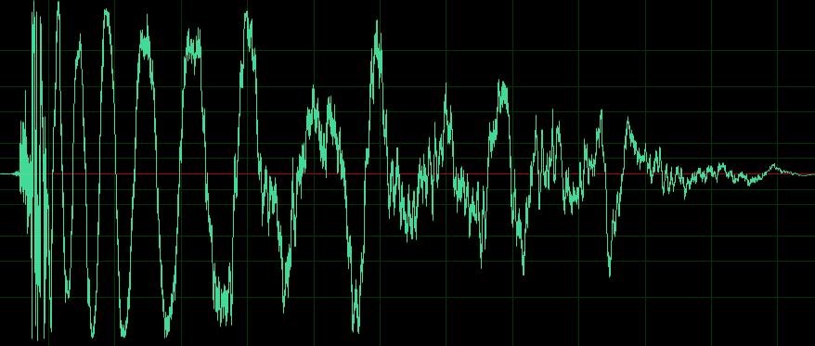
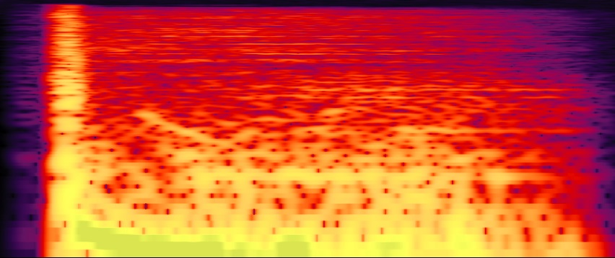
Adversarial Audio Synthesis Donahue et. al, 2018 (ICLR 2019 submission)
Adapt DCGAN architectures to audio
fixed-size images -> fixed-length audio clips
WaveGAN: DCGAN on raw waveforms
SpecGAN: DCGAN on audio spectrograms

Slide 7
Adversarial Audio Synthesis Donahue et. al, 2018 (ICLR 2019 submission)
Adapt DCGAN architectures to audio
fixed-size images -> fixed-length audio clips
WaveGAN: DCGAN on raw waveforms
SpecGAN: DCGAN on audio spectrograms
spectrograms: time-frequency representation
non-invertible (phase info lost)
approximate inverse: Griffin-Lim [1]
degrades audio quality
[1] Griffin & Lim, IEEE Trans. Acoust., Speech, Signal Process. 1984.

Slide 8
Adversarial Audio Synthesis Donahue et. al, 2018 (ICLR 2019 submission)
Adapt DCGAN architectures to audio
fixed-size images -> fixed-length audio clips
WaveGAN: DCGAN on raw waveforms
SpecGAN: DCGAN on audio spectrograms
Findings:
training methods: WGAN-GP loss [4] works best
compared to traditional GAN [1], LSGAN [2], WGAN [3] losses
quantitative results: SpecGAN > WaveGAN
qualitative results: WaveGAN > SpecGAN
[1] Radford et. al, ICLR 2016.
[2] Mao et. al, ICCV 2017.
[3] Arjovsky et. al, ICML 2017.
[4] Gulrajani et. al, NIPS 2017.

Slide 9
METHOD: Representations
To address the problem of generating audio clips consisting of 16384 samples, at a sample rate of 16 kHz.
Representations which helps to retain phase information.
A fixed transformation is applied to all input audio data, and its inverse is applied to the generator output to produce audio signals.
Short-time Fourier Transform (STFT)
Short-time Discrete Cosine Transform (STDCT)
Data Scaling And Normalization
The magnitudes of the DFT and DCT outputs are scaled logarithmically both to simulate human auditory perception and to better bound the range of values
Further, the magnitudes of the data are rescaled on a per-frequency basis

Slide 10
Short-time Fourier Transform (STFT)
Taking Fourier transformation for short time frames of the audio signal
Hann windows of length 256 with a stride of 128 samples
Zero-pad the boundaries: For complete reconstruction
This yields 256 complex values for each of the 129 windows
Real signal -> Hermitian symmetry -> discard upper 127 frequencies
Time and frequency dimensions as a 2D spatial grid: a single-channel complex-valued image of shape (129, 129, 1)
Separate the real and imaginary components into individual channels: an equivalent real image of shape (129, 129, 2)
Final image has shape (128, 128, 2)
Nyquist Frequency discarded -> 128 Frequencies
To preserve equal spatial dimensions, number of time windows were reduced to 128

Slide 11
Short-time Discrete Cosine Transform (STDCT)
Type-II DCT –
computes the DFT of a signal’s even extension.
Hann windows of length 256 with a stride of 64 samples –
still maintains the constant overlap-add property.
Discard the zero-padded windows at the end to yield a real image of shape (256, 256, 1)

Slide 12

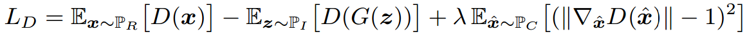
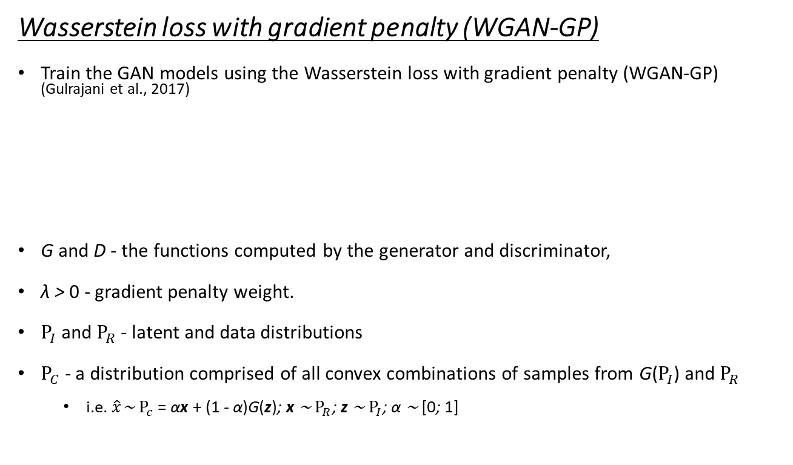
METHOD: Architectures
Wasserstein loss with gradient penalty (WGAN-GP)
Train the GAN models using the Wasserstein loss with gradient penalty (WGAN-GP) (Gulrajani et al., 2017)
G and D - the functions computed by the generator and discriminator,
λ > 0 - gradient penalty weight.
$Ρ_{I}$ and $Ρ_{R}$ - latent and data distributions
$Ρ_{C}$ - a distribution comprised of all convex combinations of samples from G($Ρ_{I}$) and $Ρ_{R}$
i.e. $\hat{x}$∼ $Ρ_{c}$ = αx + (1 - α)G(z); x ∼ $Ρ_{R}$; z ∼ $Ρ_{I}$; α ∼ [0; 1]

Slide 13
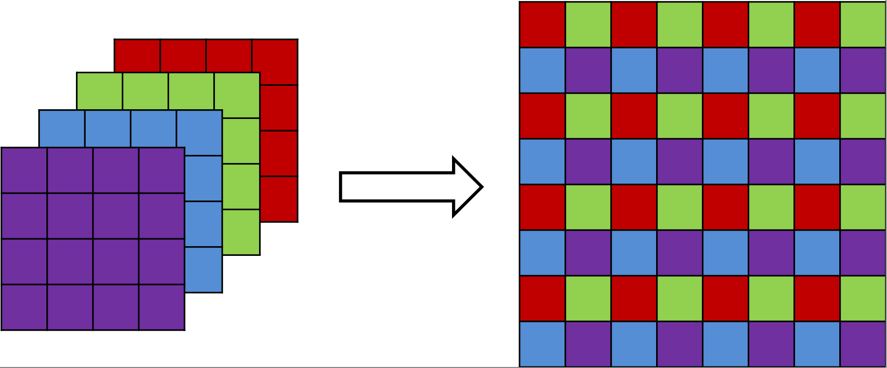
Sub-Pixel (SP) Convolution
Alternative to transpose convolutions (Shi et al., 2016)
As transpose convolutions are prone to producing “checkerboard” artifacts (Odena et al., 2016)
Regular convolutions followed by “sub-pixel shuffling”

Slide 14
Trained GAN Models
DFT GAN
Generator output and Discriminator input to have 2 channels
Kernel weights are initialized using He uniform initialization for operations directly preceding ReLU or leaky ReLU, and Glorot uniform initialization for all other operations.
All layers also have biases, which are zero-initialized.
DCT GAN
Transposed convolution layer at the end of the Generator architecture
Transposed convolution layer at the beginning of the Discriminator architecture
This allows the generator’s output and discriminator’s input to have the correct dimensions for our DCT representation
Weights and biases are initialized as in DFT GAN

Slide 15
Trained GAN Models (ctd)
DFT-SP GAN and DCT-SP GAN
Copy the architectures for the DFT and DCT GANs and replace the 5×5 stride-2 transpose convolutions of the generators with 3×3 sub-pixel convolutions.
To maintain the same effective receptive field as the replaced transpose convolutions.

Slide 16
Discussion
Discussion of results goes here

Slide 17
Future work
Experiment with more models
Subpixel shuffling with WaveGAN
Train with different kinds of audio
Sound effects
Musical instruments
Try different network architectures

